Slide 1

Retailer Billing & Management Software

Slide 2
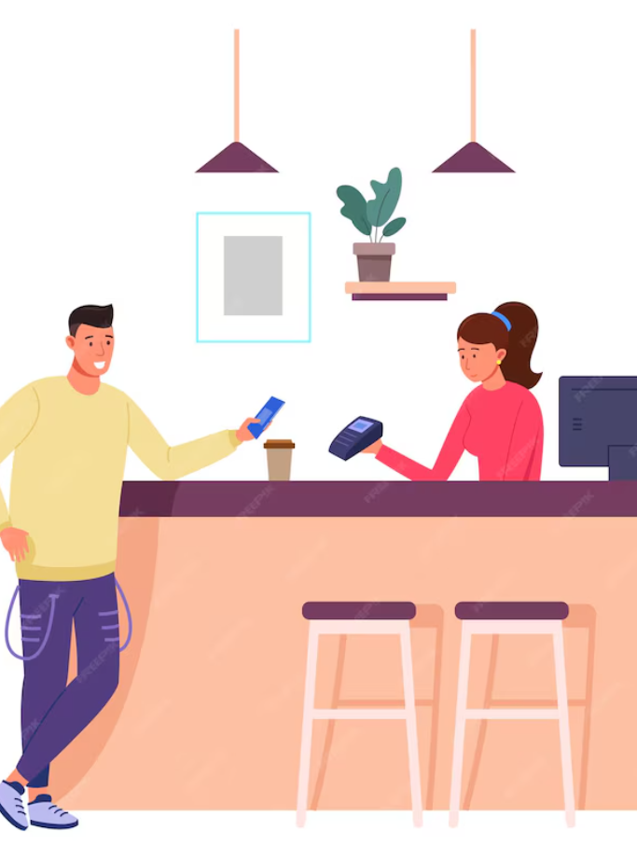
Retailer Billing & Management Software
PowerPoint Presentation

Slide 3
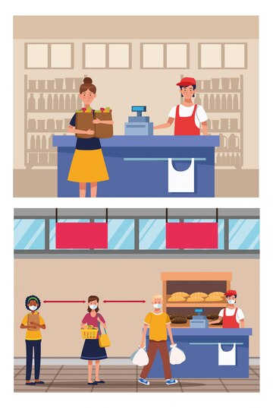

ABOUT POS
POS software stands for point-of-sale software. It is a software application that helps businesses track sales transactions, manage inventory, and run other aspects of their operations.
POS systems can be used in a variety of businesses, including retail stores, restaurants, bars, and salons. They can be cloud-based or on-premise, and they can be used on a variety of devices, including computers, tablets, and smartphones.
READ MORE

Slide 4
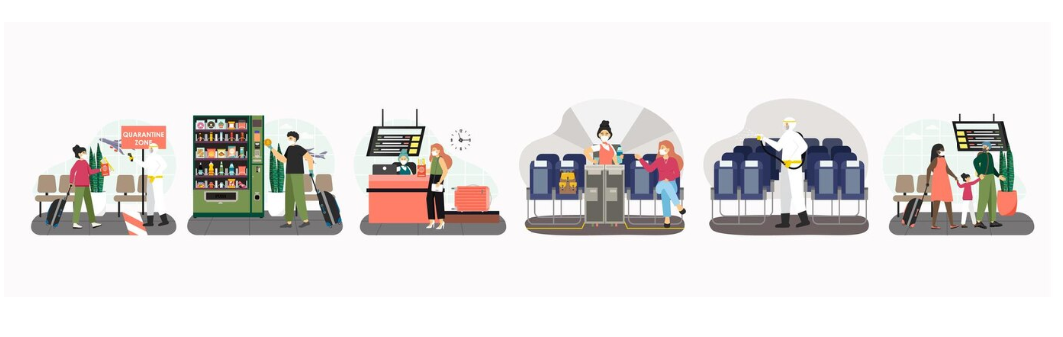
INTRODUCTION
Welcome to
Retailer Billing & Management Software
Ever wondered how modern businesses handle sales so smoothly? The secret lies in POS software! It's more than just a cash register; it's a powerful tool that simplifies transactions, manages inventory, and keeps your customers happy.

Slide 5
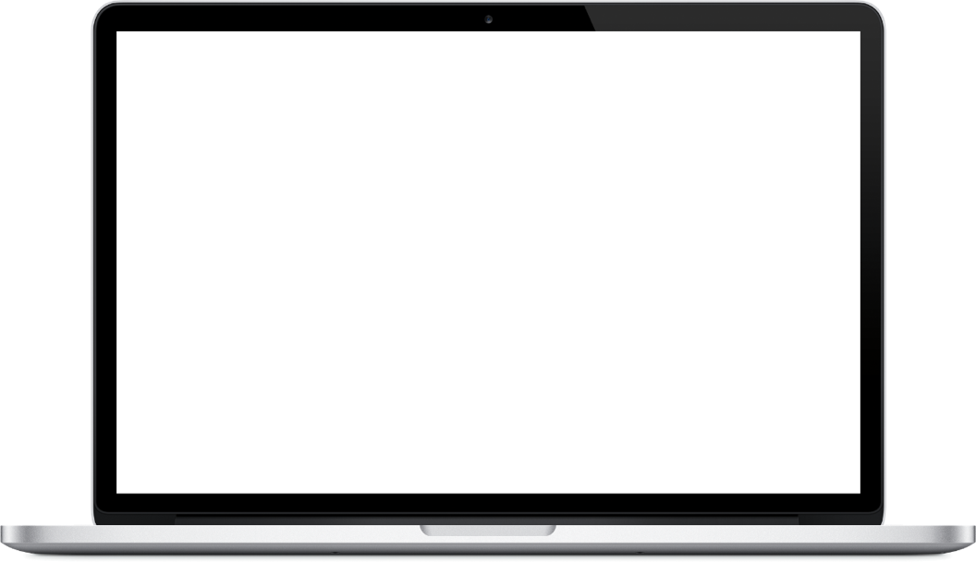
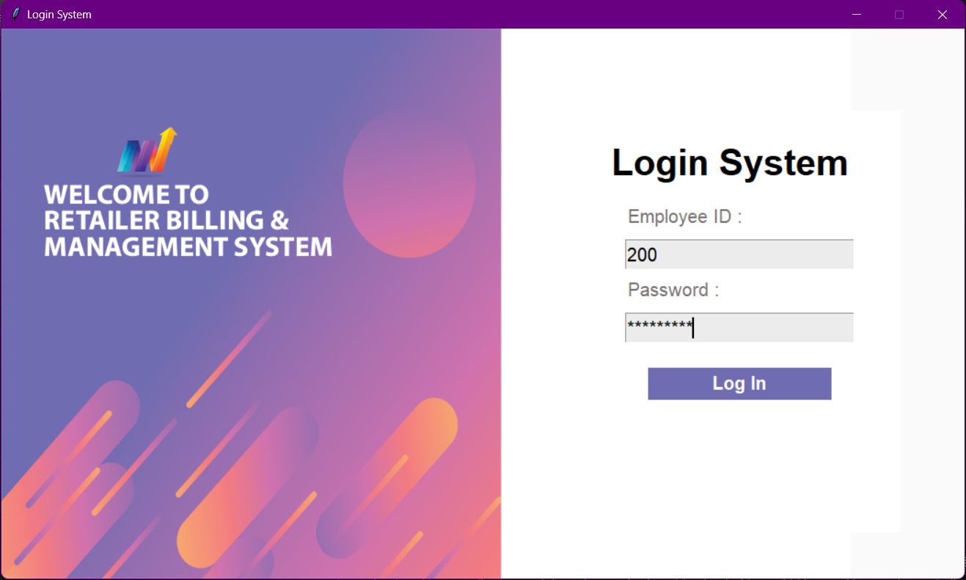


MOCKUP DEVICE
Easy Login for Everyone
Welcome to the user-friendly login system of Retailer Billing & Management Software This secure gateway ensures smooth access for both employees and administrators. We've designed it with simplicity and efficiency in mind, allowing you to quickly get started and leverage the full potential of our software.
01. Admin login
Administrators benefit from a secure and convenient login system, allowing them to quickly access and manage system settings
LOGIN
SYSTEM
02. Employee login
A convenient login process allows employees to log in quickly and begin using the software efficiently.

Slide 6
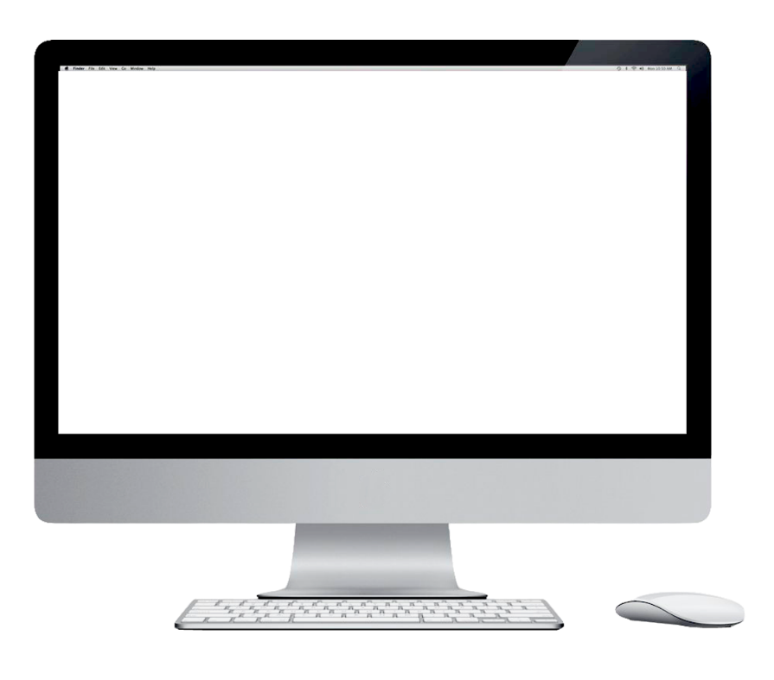
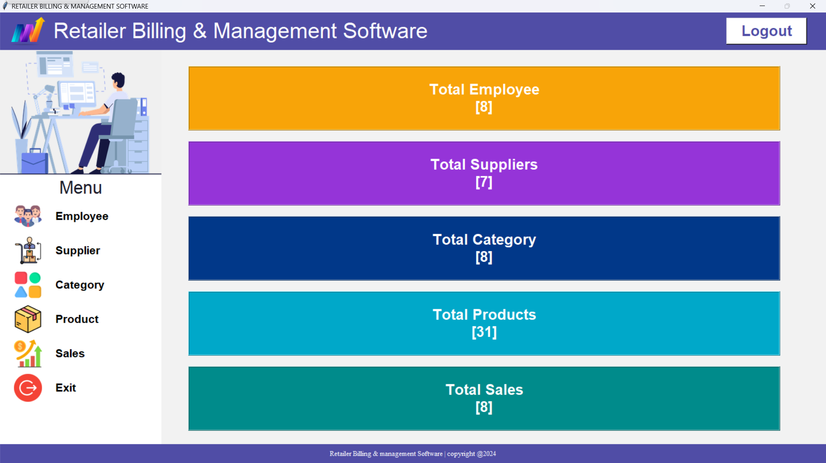



MOCKUP DEVICE
Start With A Quick Guide About Admin Dashboard
This dashboard grants administrators a comprehensive view of key metrics, including total categories, products, sales, and employee etc.
Highlight Comprehensive Insights
Focus on Management Capabilities
Emphasize
Data
Visualization
Admin Dashboard

Slide 7
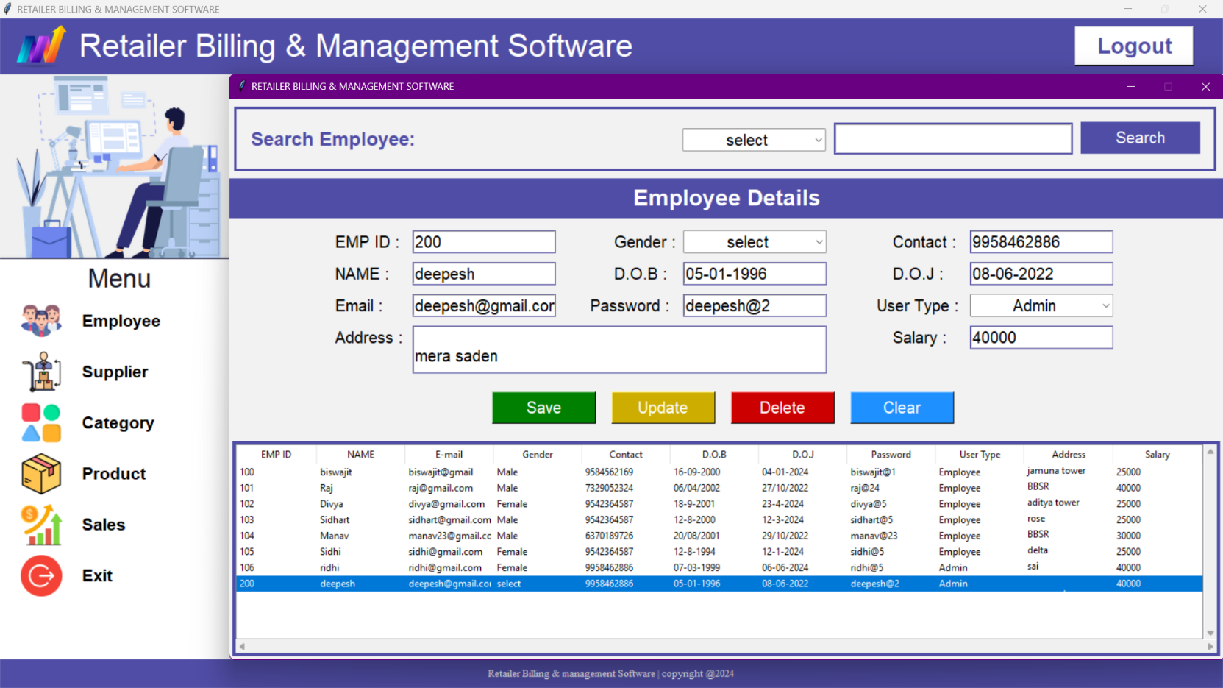
MOCKUP DEVICE
The employee menu empowers administrators to perform essential workforce management tasks: adding new employees, updating existing details, and making necessary adjustments to the central employee database. This menu seamlessly integrates with the login system for a unified user experience
Employee
Menu

Slide 8
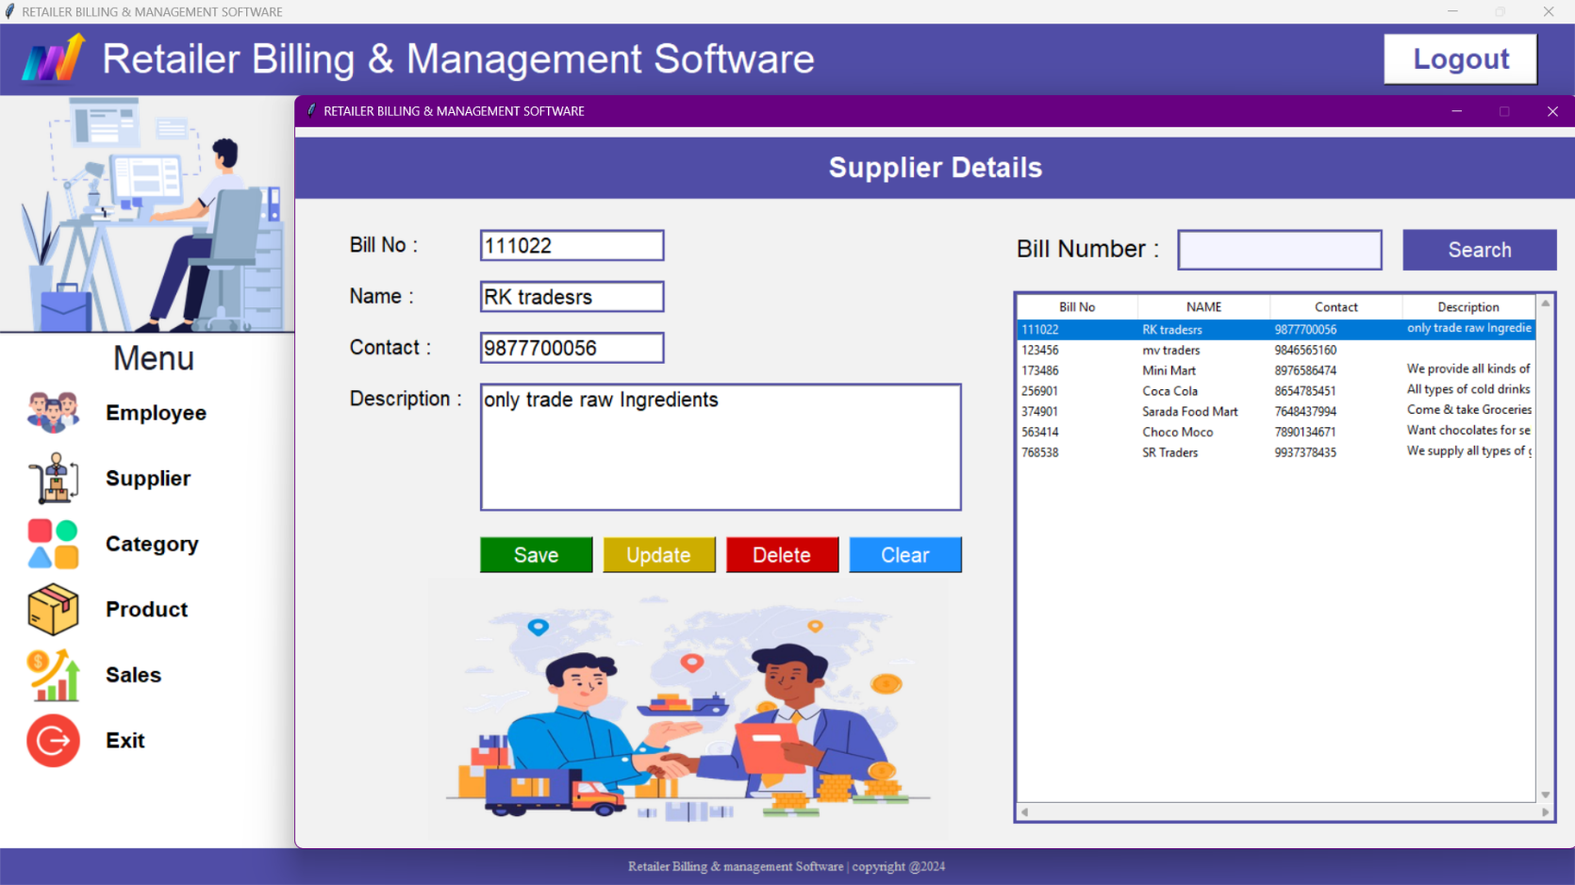
MOCKUP DEVICE
The supplier menu offers administrators a centralized platform for managing supplier relationships. This includes adding new suppliers, updating existing details, and maintaining accurate data within the supplier database.
Supplier
Menu

Slide 9
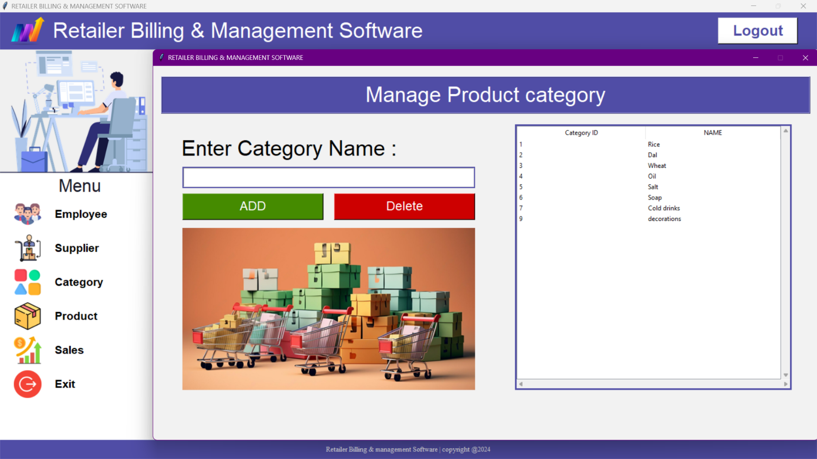
MOCKUP DEVICE
The category menu empowers administrators with comprehensive category management tools. This enables them to create new categories for enhanced product organization and update existing categories as needed, ensuring optimal data structure within the system.
Category
Menu

Slide 10
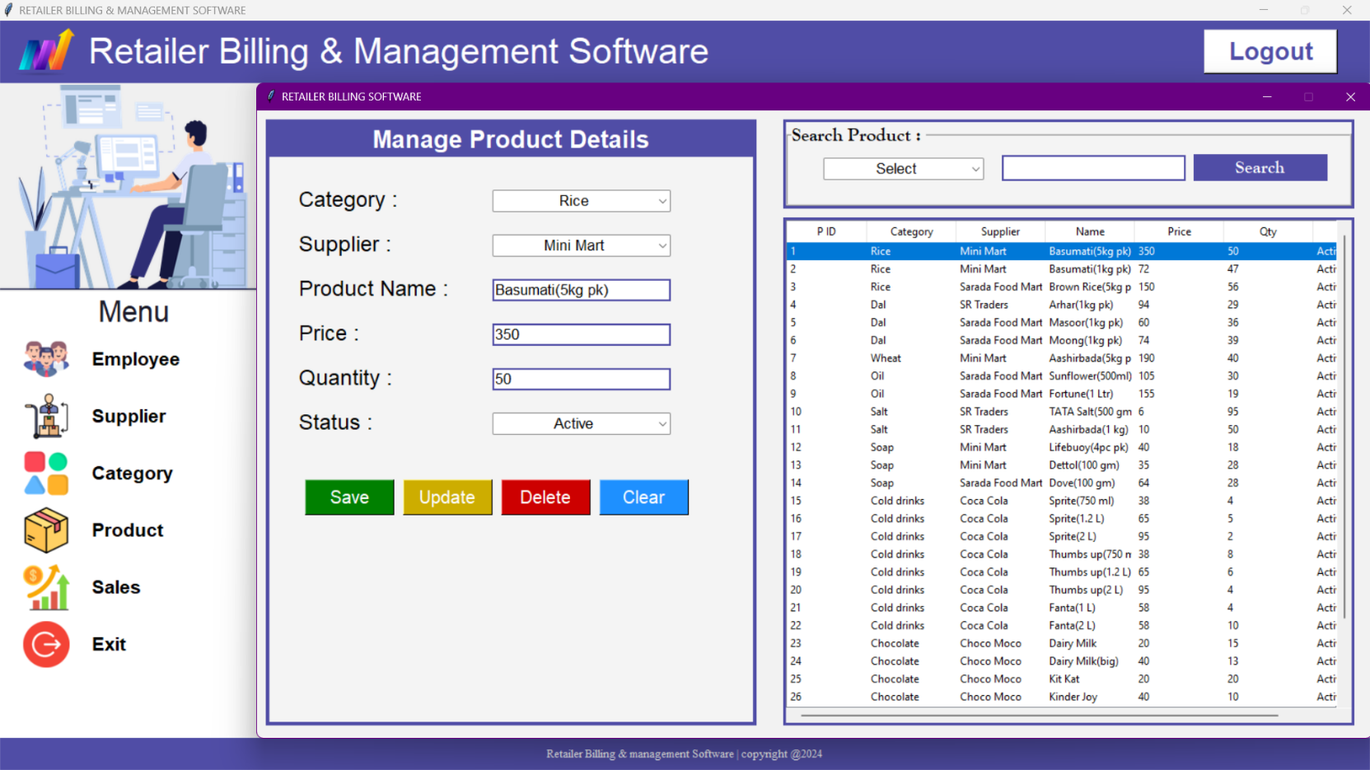
MOCKUP DEVICE
The product menu offers a seamless connection to the supplier menu, facilitating a unified product management experience for administrators. This interface empowers them to add new products to the system, remove outdated or discontinued products, and update product quality information for accurate inventory management.
Product
Menu

Slide 11
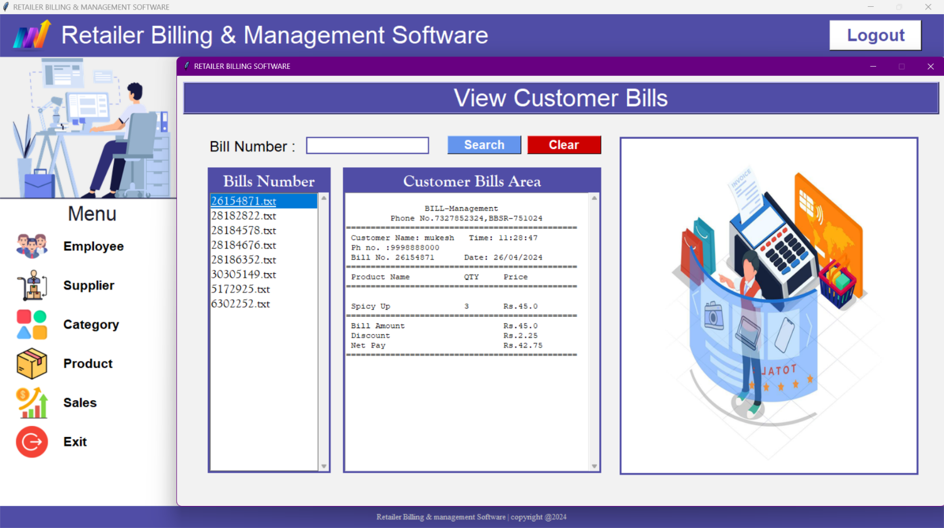
MOCKUP DEVICE
The sales menu provides administrators with a real-time overview of all sales transactions generated by the billing system. This centralized dashboard facilitates comprehensive sales monitoring and analysis.
Sales
Menu

Slide 12
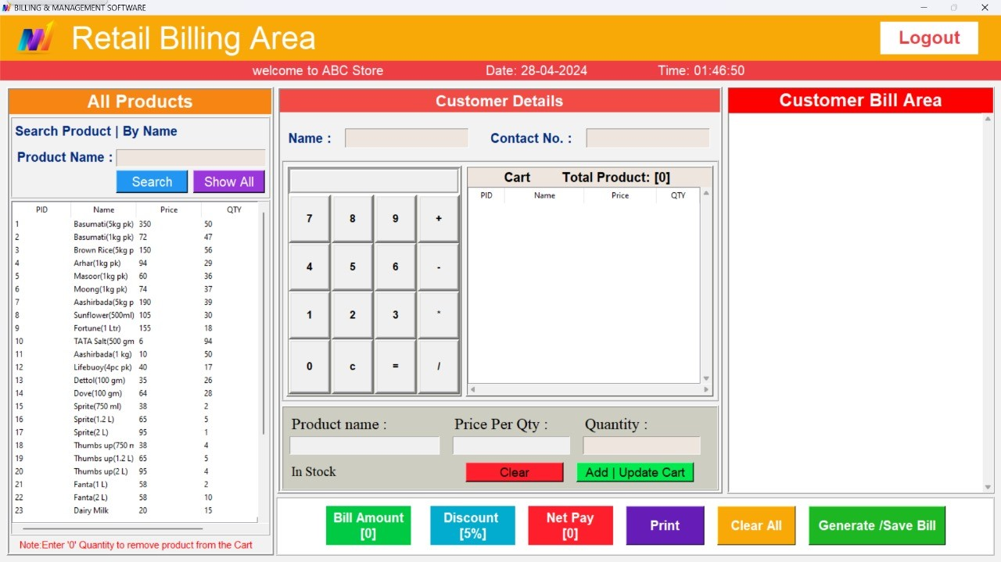
MOCKUP DEVICE
Retail Billing Area
This is All Products category
The retail billing area empowers employees to facilitate customer purchases efficiently. Employees can select products directly or leverage a comprehensive product search function within the 'All Products' menu, ensuring a smooth and streamlined checkout process.

Slide 13
MOCKUP DEVICE
Retail Billing Area
This is Customer Details and cart category
The customer details section empowers employees to manage customer information efficiently. Here, employees can input customer names and phone numbers for accurate bill generation. Additionally, this section provides valuable tools to enhance the checkout process, including a built-in calculator for price calculations and a 'Total Products' function that automatically calculates the overall purchase amount.

Slide 14
MOCKUP DEVICE
Retail Billing Area
This is Generate/save bill
This panel facilitates a streamlined checkout process for employees. It automatically calculates the total bill amount with a pre-set 5% discount, allowing for swift and accurate transactions. Additionally, employees can effortlessly print the bill for customer records, while the system seamlessly saves a copy for internal administration within the secure admin panel.

Slide 15
MOCKUP DEVICE
Retail Billing Area
This is Customer Bill/Area
The customer bill area offers a valuable preview function, allowing employees to meticulously review all bill details before finalizing and printing. This enhances accuracy and ensures customer satisfaction.

Slide 16
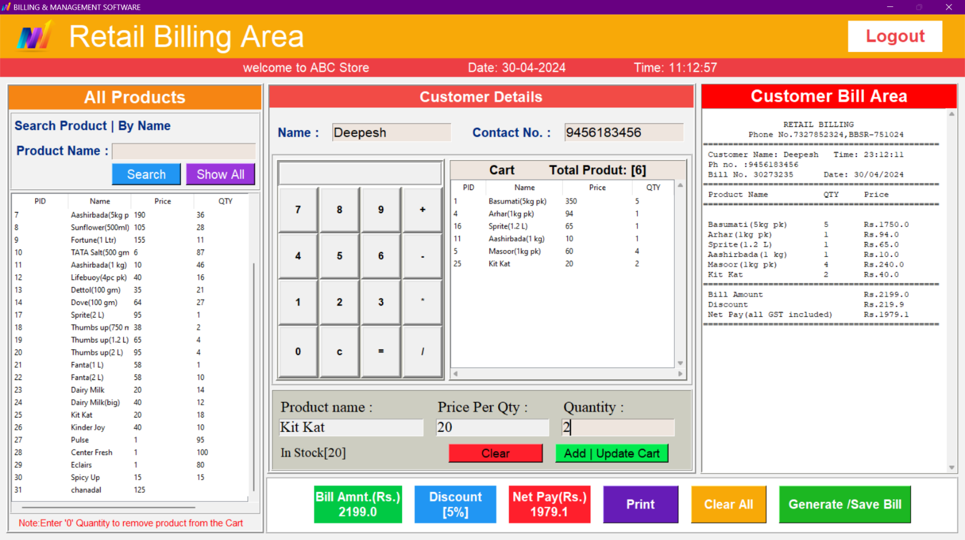
Let’s make a bill
Following efficient customer information entry (name and phone number) and product selection with corresponding quantities, the system automatically calculates the net bill amount. This streamlined workflow empowers employees to finalize the transaction with a simple click on the 'Generate/Save Bill' button, ensuring both bill generation and secure record-keeping within the system.

Slide 17
Thank You
PowerPoint Presentation
Retailer Billing & Management Software

